Slide 1
Rasterization
Foley, Ch: 3
Upto 3.1, 3.2 (upto 3.2.3), 3.3, 3.6 (upto 3.6.3)

Slide 2
Overview
Scan conversion : mapping objects/shapes to pixels
Fast image generation (e.g. in computer games)
Simple Raster Graphics Package (SRGP)
Scan converting lines
Scan converting circles
Scan converting polygons

Slide 3
Pixels in SRGP
Pixels are represented as circles centered on uniform grid
Each (x,y) of the grid has a pixel
Y
(1,2)
(1,1)
(0,0)
X

Slide 4
Scan Converting Lines
If the line has slope, m = 1
Incremental along x and y axis is 1
Y
(0,0)
X

Slide 5
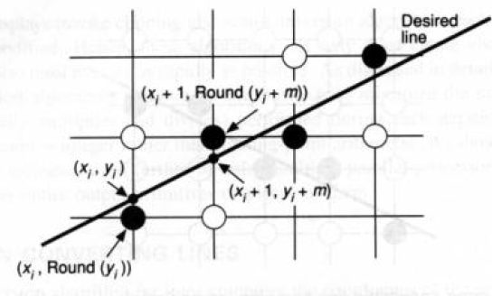
Scan Converting Lines
If the line has slope < 1
Increment along x is 1, increment along y is fractional
Round the value along y axis

Slide 6
Scan Converting Lines
If the line has slope > 1
Increment along y is 1, increment along x is fractional
Round the value along y axis
Y
(0,0)
X

Slide 7
Scan Converting Lines : Basic Incremental Algorithm
Two end points (x_{o},y_{o}) and (x₁,y₁)
Calculate slope m = (y₁-y₀) / (x₁-x₀)
If (m<1):
y_{i+1} = mx_{i+1} + B
= m(x_{i} + Δx) + B
= (mx_{i} + B) + mΔx
= y_{i} + mΔx
= y_{i} + m
So next point to intensify is (x_{i+1}, round(y_{i+1})) where x_{i+1}= x_{i}+1

Slide 8
Scan Converting Lines : Basic Incremental Algorithm
Two end points (x_{o},y_{o}) and (x₁,y₁)
Calculate slope m = (y₁-y₀) / (x₁-x₀)
If(m>1) (Steeper):
x_{i+1} = (y_{i+1} – B)/m
= ((y_{i} + Δy) – B)/m
= (y_{i} - B)/m + Δy/m
= x_{i} + 1/m
So next point to intensify is (round(x_{i+1}), y_{i+1}) where y_{i+1}= y_{i}+1
Y
(0,0)

Slide 9
Scan Converting Lines : Basic Incremental Algorithm
Basic Incremental Algorithm Problems:
Handle fractional values → Rounding takes time
Working with real numbers (e.g. y, m)
… etc.
Solution: Midpoint Line Algorithm
Only integer arithmetic
Avoid rounding

Slide 10
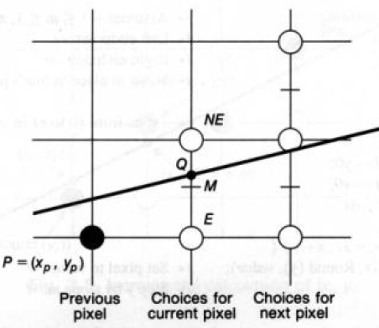
Scan Converting Lines : Midpoint Line Algorithm
Assumption : Slope is between 0 and 1
Lower end point (x_{o},y_{o}) and upper point (x₁,y₁)
Initially we are at P(x_{p},y_{p})
Choose between NE and E
Midpoint M is (x_{p}+1, y_{p}+1/2)
M lies on which side of the line?
M is on the line → any pixel NE / E
M is below the line → choose NE
M is above the line → choose E
Find the equation of the line f (x,y)
f (x,y) = ax + by + c a = dy; b = -dx; c = dx.B (B is the y-intercept in the slope-intercept form)
Let d = f (M) = f (x_{p}+1, y_{p}+1/2)
d = 0 → M is on the line d > 0 → M is below the line d < 0 → M is above the line

Slide 11
Scan Converting Lines : Midpoint Line Algorithm
Find the next value of the decision variable d?
Need to apply incremental approach
Two cases:
If E is chosen
If NE is chosen

Slide 12
Scan Converting Lines : Midpoint Line Algorithm
Find the next value of the decision variable d?
Need to apply incremental approach
If E is chosen :
New Midpoint: M_{E} (x_{p}+2, y_{p}+ 1/2)
New decision variable, d_{new}
= f (M_{E}) = f (x_{p}+2, y_{p}+ 1/2)
= f (x_{p}+1, y_{p}+ 1/2) + dy.1
= d_{old}+ dy So, d_{E} = dy
M_{E}

Slide 13
Scan Converting Lines : Midpoint Line Algorithm
Find the next value of the decision variable d?
Need to apply incremental approach
If NE is chosen :
New Midpoint: M_{NE} (x_{p}+2, y_{p}+ 3/2)
New decision variable d_{new}
= f (M_{NE}) = f(x_{p}+2, y_{p}+ 3/2)
= f (x_{p}+1, y_{p}+ 1/2) + dy.1- dx.1
= d_{old} + dy – dx So, d_{NE} = dy - dx
M_{NE}

Slide 14
Scan Converting Lines : Midpoint Line Algorithm
Initial value of decision variable d_{start}
Start point (x_{o},y_{o})
d_{start} = f (x_{o}+1, y_{o}+ 1/2)
= f (x_{o}, y_{o}) + dy - dx/2 = dy - dx/2
Here the fraction in dx/2 can be avoided by
considering f(x,y) = 2(ax+by+c)

Slide 15
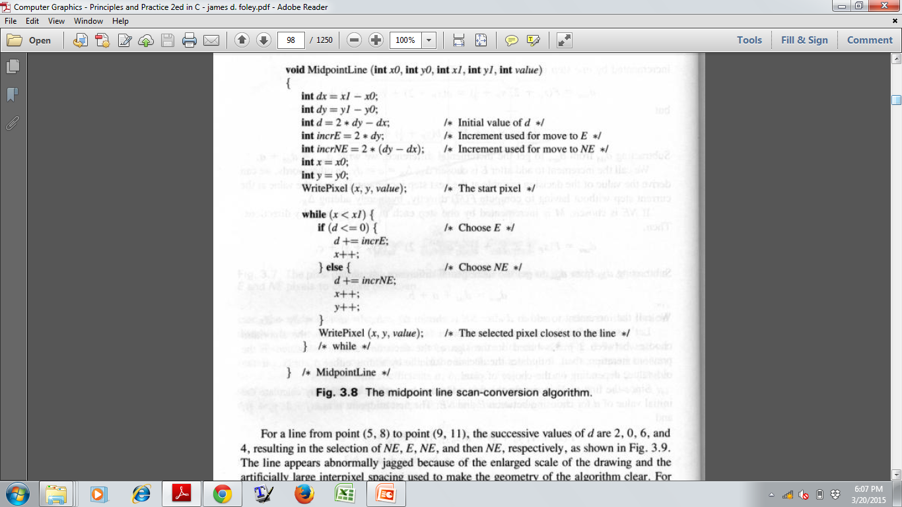
Simple addition and comparison

Slide 16
Scan Converting Lines : Midpoint Line Algorithm
The algorithm works for 0<=m<=1
What about other slopes?
Think!

Slide 17
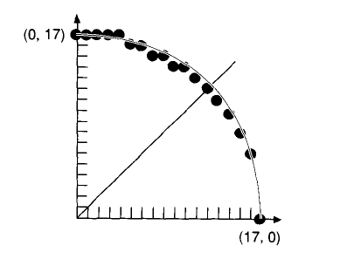
Scan Converting Circles
Naive Approach (expensive computation)
For a circle centered at the origin, y = √(R² - x²)
Draw a quarter by incrementing x from 0 to R in unit steps
Circles not centered at the origin, can be translated for computation and pixels can be written with appropriate offsets
Large gaps for values of x close to R

Slide 18
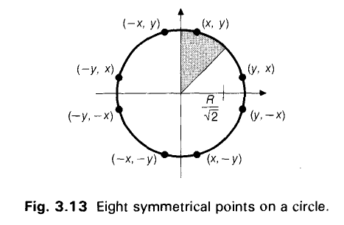
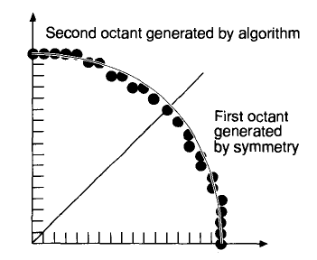
Scan Converting Circles
Another Inefficient Method
For a circle centered at the origin, y = RcosӨ, x = RsinӨ
Vary Ө from 0 to 90 degree uniformly and plot x, y
Avoids large gaps but still computationally inefficient
Eight Way Symmetry

Slide 19
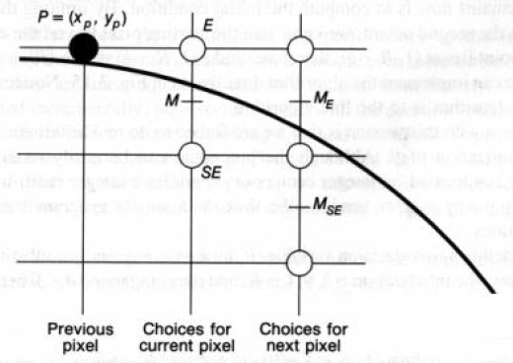
Scan Converting Circles : Midpoint Circle Algorithm
Compute for the second octant only i.e. 45⁰ of the circle, from x = 0 to x = R/√2
Say, currently we are at P(x_{p}, y_{p}).
Choose between E or SE based on midpoint M(x_{p}+1, y_{p} - 1/2)
M lies inside or outside the circle?
M is outside the circle → choose SE
M is inside the circle → choose E
M is on the circle → any pixel SE /E

Slide 20
Scan Converting Circles : Midpoint Circle Algorithm
Use f (x,y) = x² + y² – R²
d = f(M) = f (x_{p}+1, y_{p} - 1/2)
d = 0 : M is on the circle → any pixel SE/E
d > 0 : M is outside the circle → choose SE
d < 0 : M is inside the circle → choose E

Slide 21
Scan Converting Circles : Midpoint Circle Algorithm
After we reach E or SE, what is the new value of d?
Case 1-We are at E:
New midpoint M_{E}(x_{p}+2, y_{p} - 1/2)
d_{new} = f (M_{E}) = f(x_{p}+2, y_{p} - 1/2) = d_{old} + (2x_{p} + 3) = d_{old} + ΔE
d_{new} > 0 → M is outside the circle → Choose SE’
d_{new} < 0 → M is inside the circle → Choose E’
d_{new} = 0 → M is on the circle → Choose E’ / SE’
P(x_{p}, y_{p})
E
E’
M
M_{E}
SE’
SE

Slide 22
Scan Converting Circles : Midpoint Circle Algorithm
After we reach E or SE, what is the new value of d?
Case 2-We are at SE:
New midpoint M_{SE}(x_{p}+2, y_{p} – 3/2)
d_{new} = f (M_{SE}) = f(x_{p}+2, y_{p} – 3/2) = d_{old} + (2x_{p} – 2y_{p} + 5) = d_{old} + ΔSE
d_{new} > 0 → M is outside the circle → Choose SE’
d_{new} < 0 → M is inside the circle → Choose E’
d_{new} = 0 → M is on the circle → Choose E’ / SE’
P(x_{p}, y_{p})
E
M
E’
SE
M_{SE}
SE’

Slide 23
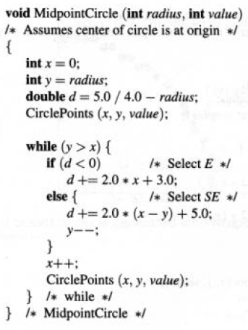
Scan Converting Circles : Midpoint Circle Algorithm
Initial Value of d: d_{start} = f(1, R-½) = 1² + (R-½)² - R² = 1 + R² – 2.R. ½ + (½) ² – R² = 1 + 1/4 – R = 5/4 – R

Slide 25
Scan Converting Circles : Midpoint Circle Algorithm
Initial Value of d:
d_{start} = 5/4 – R
Say, h = d – 1/4 d = h+1/4
h+1/4 = 5/4 – R h = 1 – R
h = -1/4 → M is on the circle → any pixel SE/E h > -1/4 → M is outside the circle → choose SE h < -1/4 → M is inside the circle → choose E
If h starts out with integer value and gets incremented by integer value (ΔE or ΔSE) then the comparisons, h = -1/4, h > -1/4, h < -1/4 reduce to h=0, h>0, and h<0

Slide 26
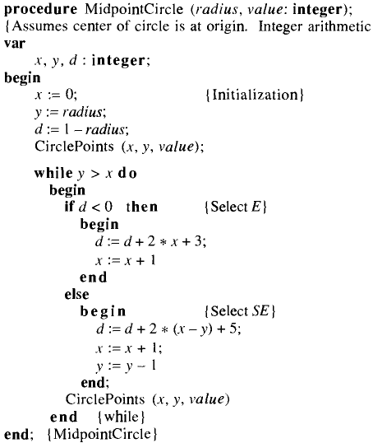
Scan Converting Circles : Midpoint Circle Algorithm
Replacing h by d

Slide 27
Scan Converting Circles : Midpoint Circle Algorithm
Improvements by second order difference:
ΔE = 2x_{p} + 3
ΔSE = 2x_{p} – 2y_{p} + 5
E is chosen → new point of evaluation is E(x_{p}+1, y_{p})
SE is chosen→ new point of evaluation is SE(x_{p}+1, y_{p}-1)
Find increments ΔE and ΔSE wrt new point of evaluation, E(x_{p}+1, y_{p}), SE(x_{p}+1, y_{p}-1)
From the point of evaluation, P(x_{p}, y_{p})

Slide 28
Second order difference wrt E(x_{p}+1,y_{p})
ΔE= 2x_{p} + 3 = ΔE_{old}
Increment in d when E is chosen
P(x_{p},y_{p})
E(x_{p}+1,y_{p})
ΔSE= 2x_{p} – 2y_{p} + 5= ΔSE_{old}
Increment in d when E is chosen
ΔE= 2(x_{p} + 1) + 3 = (2x_{p} + 3) + 2 = ΔE_{old} + 2
P(x_{p},y_{p})
E
E’
E’’
SE
SE’
SE’’

Slide 29
Second order difference wrt E(x_{p}+1,y_{p})
ΔE= 2x_{p} + 3 = ΔE_{old}
Increment in d when E is chosen
P(x_{p},y_{p})
E(x_{p}+1,y_{p})
ΔSE= 2x_{p} – 2y_{p} + 5= ΔSE_{old}
Increment in d when E is chosen
ΔE= 2(x_{p} + 1) + 3 = (2x_{p} + 3) + 2 = ΔE_{old} + 2
ΔSE=2(x_{p} +1 )– 2y_{p} + 5 = (2x_{p} – 2y_{p} + 5) + 2 = ΔSE_{old} + 2
P(x_{p},y_{p})
E
E’
E’’
SE
SE’
SE’’

Slide 30
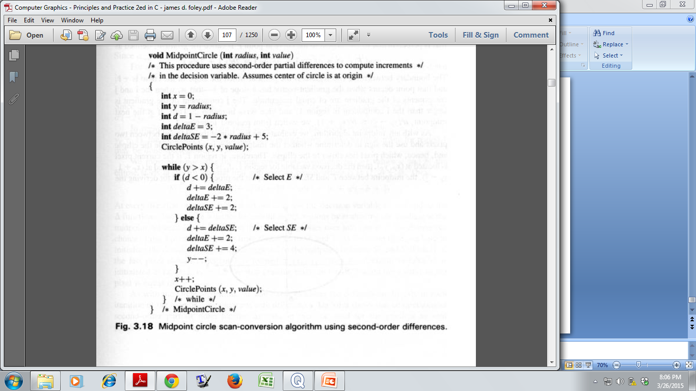
Second order difference wrt E(x_{p}+1,y_{p})

Slide 31
Second order difference wrt SE(x_{p}+1,y_{p}-1)
ΔE= 2x_{p} + 3 = ΔE_{old}
Increment in d when E is chosen
P(x_{p},y_{p})
SE(x_{p}+1,y_{p}-1)
ΔSE= 2x_{p} – 2y_{p} + 5= ΔSE_{old}
Increment in d when E is chosen
ΔE= 2(x_{p} + 1) + 3 = (2x_{p} + 3) + 2 = ΔE_{old} + 2
P(x_{p},y_{p})
E
E’’
SE
E’
SE’
SE’’

Slide 32
Second order difference wrt SE(x_{p}+1,y_{p}-1)
ΔE= 2x_{p} + 3 = ΔE_{old}
Increment in d when E is chosen
P(x_{p},y_{p})
SE(x_{p}+1,y_{p}-1)
ΔSE= 2x_{p} – 2y_{p} + 5= ΔSE_{old}
Increment in d when E is chosen
ΔE= 2(x_{p} + 1) + 3 = (2x_{p} + 3) + 2 = ΔE_{old} + 2
ΔSE=2(x_{p}+1)– 2(y_{p}-1)+5 = (2x_{p}–2y_{p}+5)+2+2=ΔSE_{old} +4
P(x_{p},y_{p})
E
SE
E’
E’’
SE’
SE’’

Slide 33
Second order difference wrt SE(x_{p}+1,y_{p}-1)

Slide 34
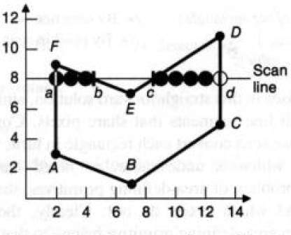
Polygon Scan Conversion
P=1
P=0
P=1
Steps:
Find the intersections of the scan line with the polygon edges
Sort the intersection points in increasing order of x coordinate
For each pair of intersections, use odd parity rule to draw the pixels that are interior to the polygon
Initially parity is even, P = 0
For each intersection, parity is changed
Draw the pixels only when the parity is odd
P=1
P=0
P=1
P=0

Slide 35
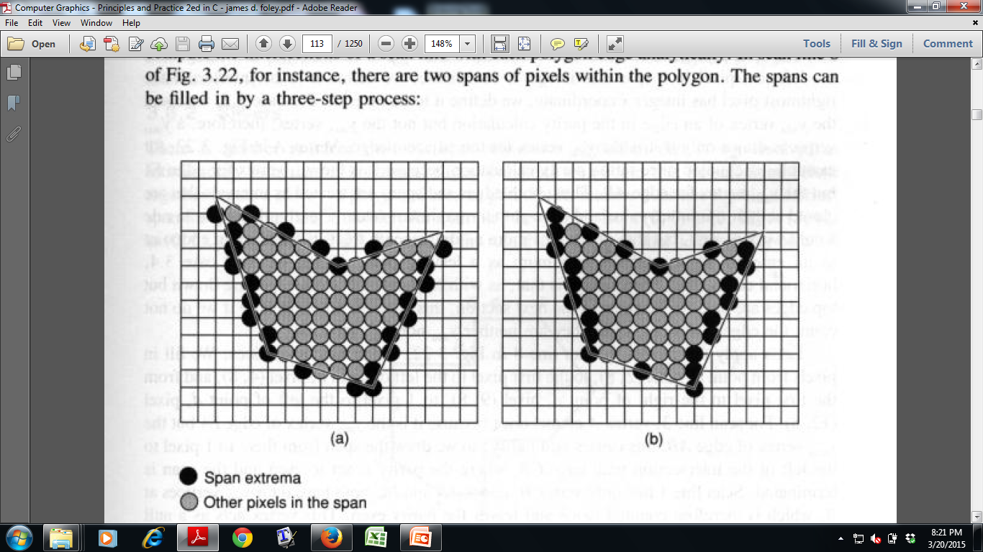
Polygon Scan Conversion
Draw only those pixels which are strictly interior to the polygon
Cases to consider:
Intersection point is fractional
Intersection point is integer
Integer intersection point that is a shared vertex
Integer intersection points that define horizontal edge

Slide 36
Polygon Scan Conversion
Intersection point is fractional
If it is the left most of the span and before intersection we were outside the polygon, then round up
If it is the right most of the span, and before intersection we were inside the polygon, then round down

Slide 37
Polygon Scan Conversion
Intersection point is integer
If it is the left most of the span, draw it
If it is the right most of the span, don’t draw it

Slide 38
Polygon Scan Conversion
Integer intersection point that is a shared vertex
Draw it only if it is y_{min} of an edge

Slide 39
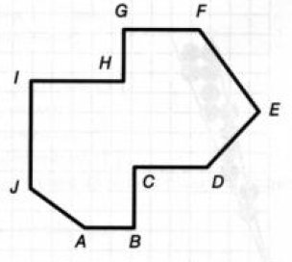
Polygon Scan Conversion
Integer intersection points that define horizontal edge
Scanline Y1:
A is a Y_{min} of JA.
A is drawn and parity becomes odd.
Through out AB, parity remains odd, the span AB is drawn.
B is Y_{min} of CB. Parity becomes even. Drawing stops.
Y1

Slide 40
Polygon Scan Conversion
Integer intersection points that define horizontal edge
Scanline Y2:
First Intersection point is drawn and parity becomes odd.
Through out the span up to C, parity remains odd, the span is drawn.
C is not Y_{min} of CD or BC. So C is not considered. Parity remains odd. Span CD is drawn.
D is Y_{min} of DE. Parity becomes even. Drawing stops.
Y2

Slide 41
Polygon Scan Conversion
Integer intersection points that define horizontal edge
Scanline Y3:
I is not Y_{min} of IH or IJ. So I is not considered. Parity remains even. Span IH is not drawn.
H is Y_{min} of GH. So H is considered and Parity becomes odd. The span up to next intersection point is drawn.
Y3

Slide 42
Polygon Scan Conversion
Integer intersection points that define horizontal edge
Scanline Y4:
G is not Y_{min} of GF or GH. So G is not considered. Parity remains even. Span GF is not drawn.
Summary:
Top edges are not drawn
Bottom edges are drawn
Y4

Slide 43
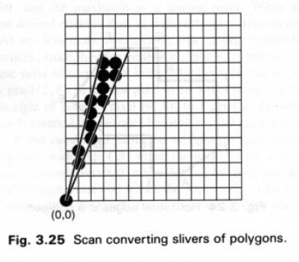
Polygon Scan Conversion
Silver : In case of thin polygon area, each scan line may not have a distinct span (e.g. a single pixel or no pixel)

Slide 44
Summary
A Brief Idea of Rasterization
Scan Conversion of Lines, Circles in Detail
Inefficient techniques and why they are inefficient
Efficient algorithms based on the position of midpoint calculation
Scan Conversion of Filled Polygons
Challenges and some conventions

Slide 45
Thank you ☺

